Slide 1
POWER BI REINFORCEMENT PROJECT
PRESENTED BY
SANJAIKUMAR S
DA & DS FEBRUARY 2025
05-JUNE-2025

Slide 2
PROJECT OBJECTIVE
Explore and analyze used car listings
Identify pricing patterns by brand, year, fuel type, and condition
Use Power BI for complete data modeling, DAX, and visualization

Slide 3
DATASET OVERVIEW
Source: Raw dataset loaded directly into Power BI
Contains 2,500 rows, 10 columns
Key fields: Brand, Model, Year, Condition, Fuel Type, Mileage, Price

Slide 4
DATA PREPERATION IN POWER QUERY
Cleaned directly in Power BI (Power Query)
Removed nulls/duplicates
Ensured correct data types
No external Excel transformation used

Slide 5
CALCULATED COLUMN USING DAX
Car Age = YEAR(TODAY()) - 'car_price_prediction_'[Year]
Calculates how many years old the car is.
Price Category =
SWITCH(
TRUE(),
'car_price_prediction_'[Price] < 300000, "Budget",
'car_price_prediction_'[Price] < 700000, "Mid-Range",
"Premium"
)
Categorizes cars into Budget, Mid-Range, and Premium segments.

Slide 6
DAX MEASURES
Total Cars
Average Price
Average Mileage
Car Count by Brand
Avg Price by Fuel Type
% by Price Category
Total of 10–12 measures used for insights

Slide 7
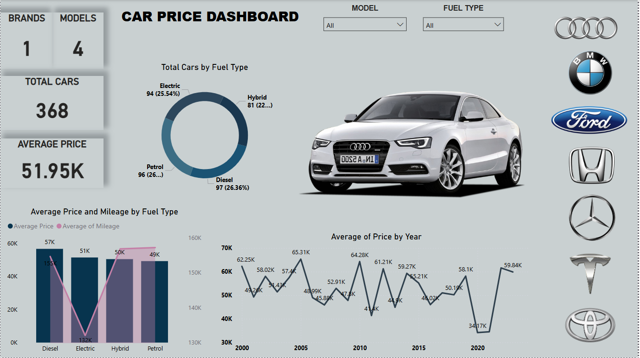

Slide 8
KEY INSIGHTS
Brands like BMW have the highest average prices
Diesel is the most common (26.2%)
Petrol, Hybrid, and Electric each contribute nearly 24–25%
Newer cars are priced significantly higher
Average price peaked in 2003, 2006, 2012 (57K)
Used cars show highest average mileage .

Slide 9
CONCLUSION
Key Insights: Fuel type and car condition affect price and mileage. Diesel cars are most common, and used cars have the highest mileage.
Price Trends: Car prices fluctuate over the years, with peaks in 2003, 2006, and 2012.
Brand Insights: Toyota has the highest car count, while Ford has the lowest, with a balanced presence across brands.

Slide 10
THANK U

